Slide 1
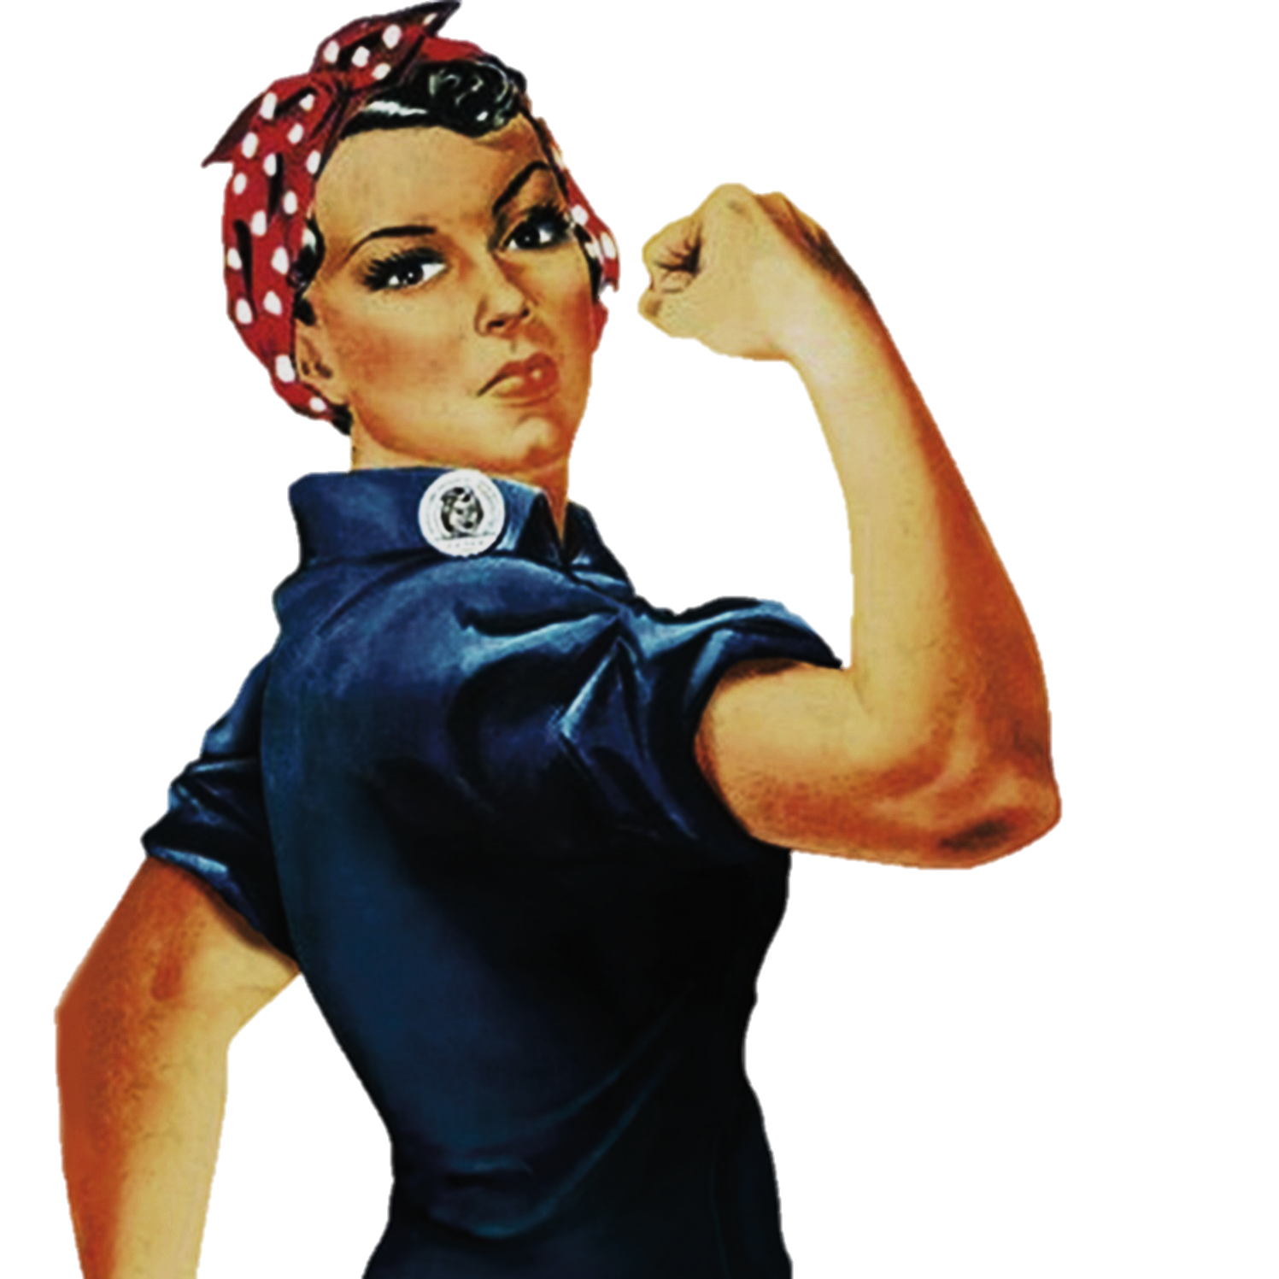
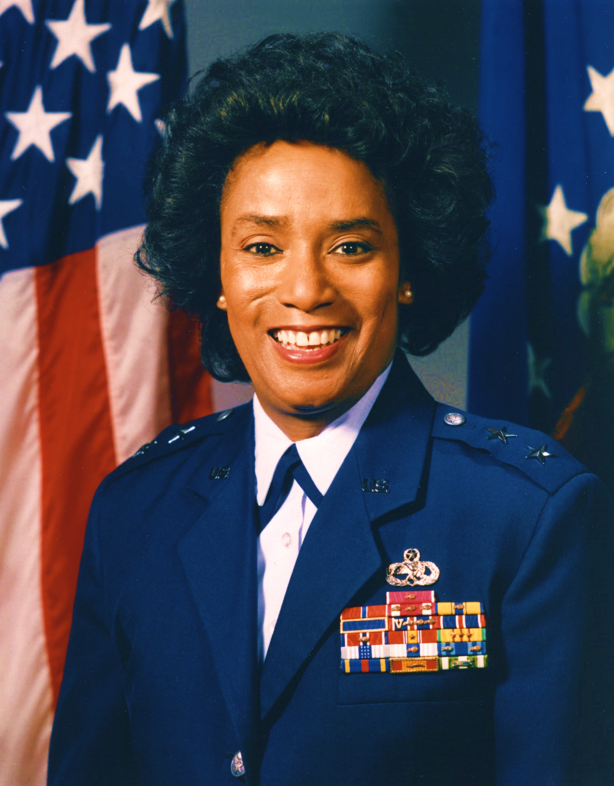

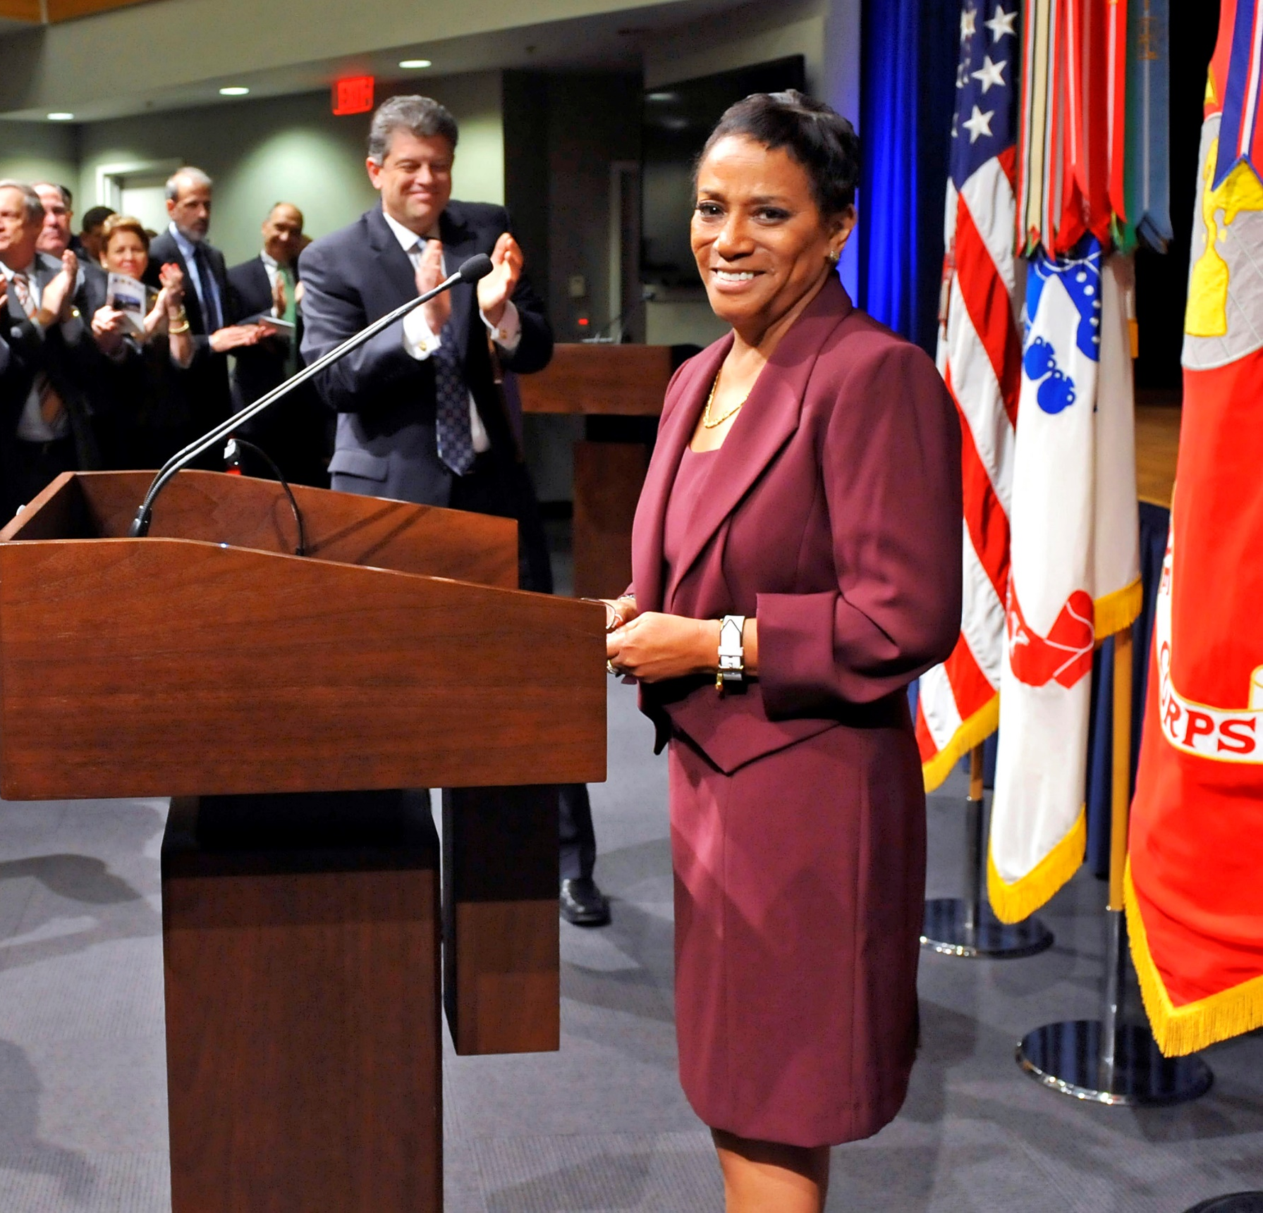
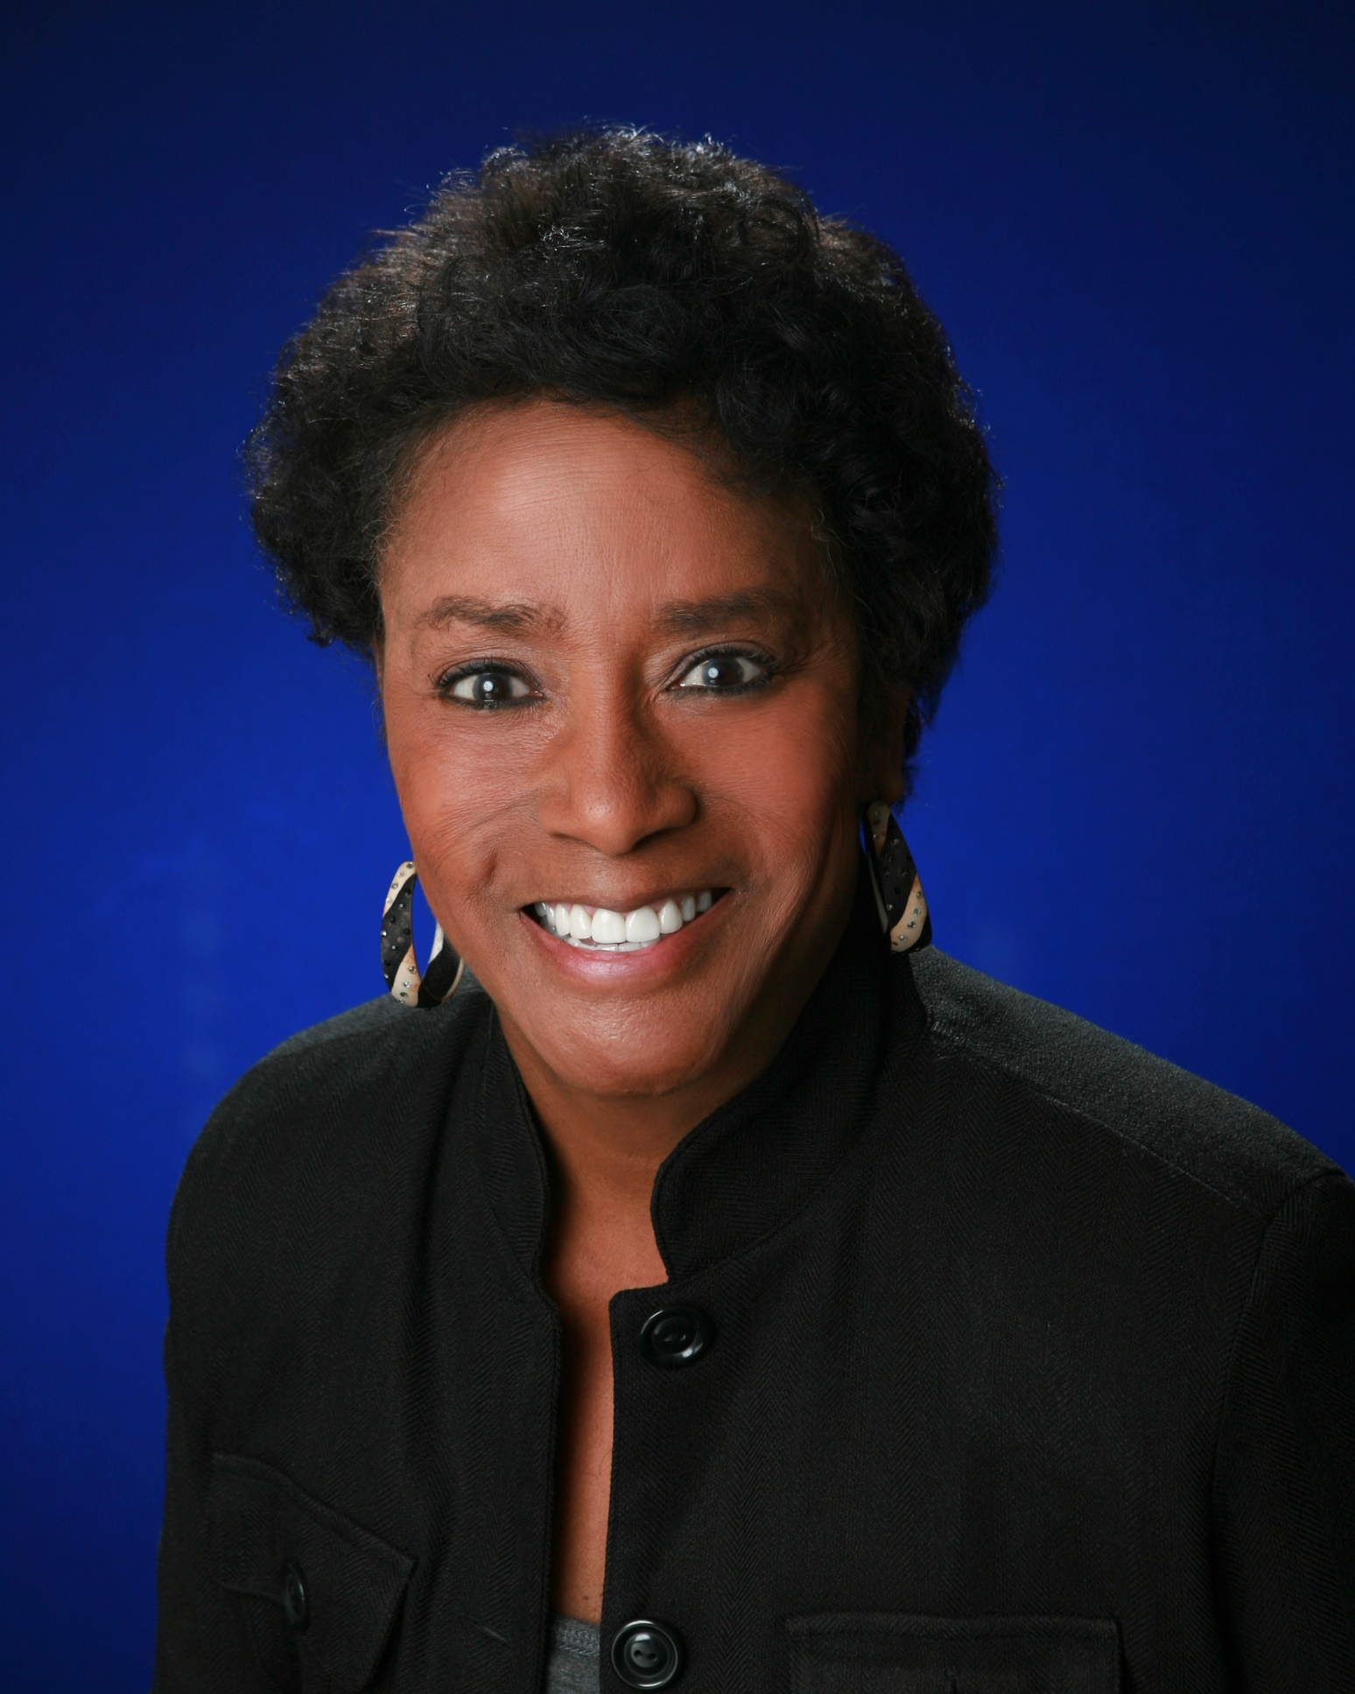
Women
Marcelite J. Harris
Major General Retired USAF
To change pictures:
Save the picture of the person you wish to use.
Single-left-click the grouped picture/shapes you wish to change on the poster. Single-left-click again on the picture.
Now single-right-click the picture and select “Change Picture” from the menu.
Choose the picture file you saved.
You may wish to single-left-click the grouped picture/shapes and single-left-click the new picture again to adjust its size or crop it—especially useful if the new picture is not the same aspect ratio as the previous one.
DO NOT CHANGE ROSIE THE RIVETER PICTURE!!!
In Technology
This amazing leader has been many “firsts!” The first female maintenance officer in the Air Force, one of the first two female Air Officers Commanding of an Air Force Academy cadet squadron, and the Air Force’s first African-American female general officer!
1975-1978 Personnel officer and aide on President Jimmy Carter’s White House staff
1988-1990 Commanded the 3300th Technical Training Wing at Keesler—the unit that would later become our own 81st TRG!
1999 Served as site director for United Space Alliance operations at the NASA Kennedy Space Center
The efforts of leaders on the leading edge of progress like Marcelite Harris help pave the way for women to pursue any path they want. About her success, she says, “The reason that I was the first to do some things is because I love my job. Therefore I did my job well. That caused people to say ‘you’re who I want.’” Her determination made a difference when every step she took was one that few or no women had taken before!
When you face a challenge for the first time, what will be your key to success?

